Slide 2
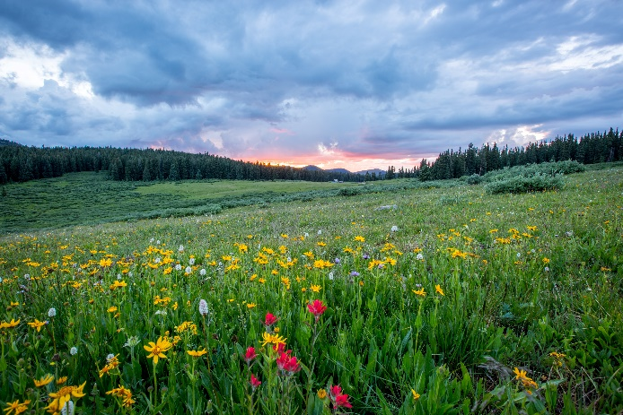
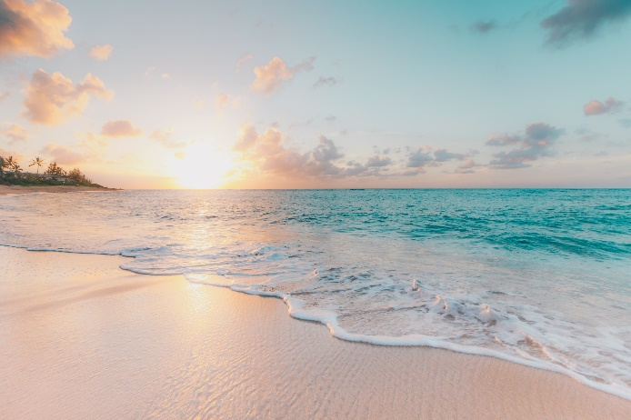
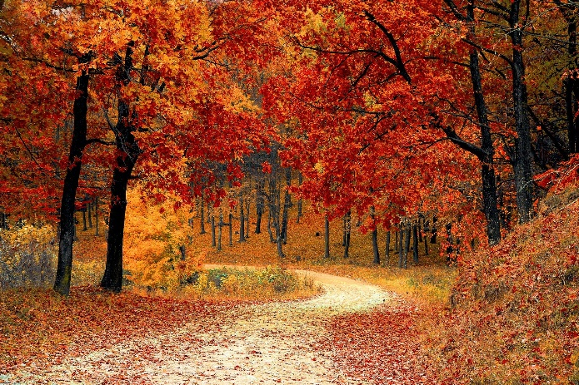
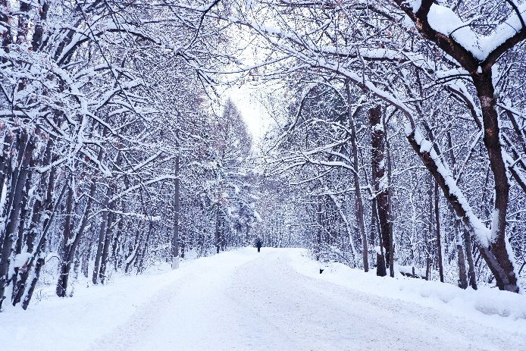
What is Autumn?
Autumn is one of the four seasons.
spring
summer
autumn
winter

Slide 3
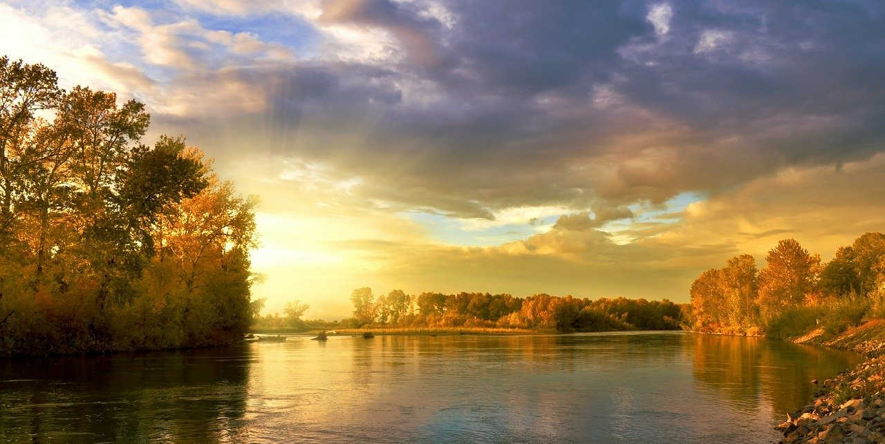
What is the Weather like in Autumn?
During autumn, the days start to get shorter and colder.

Slide 4
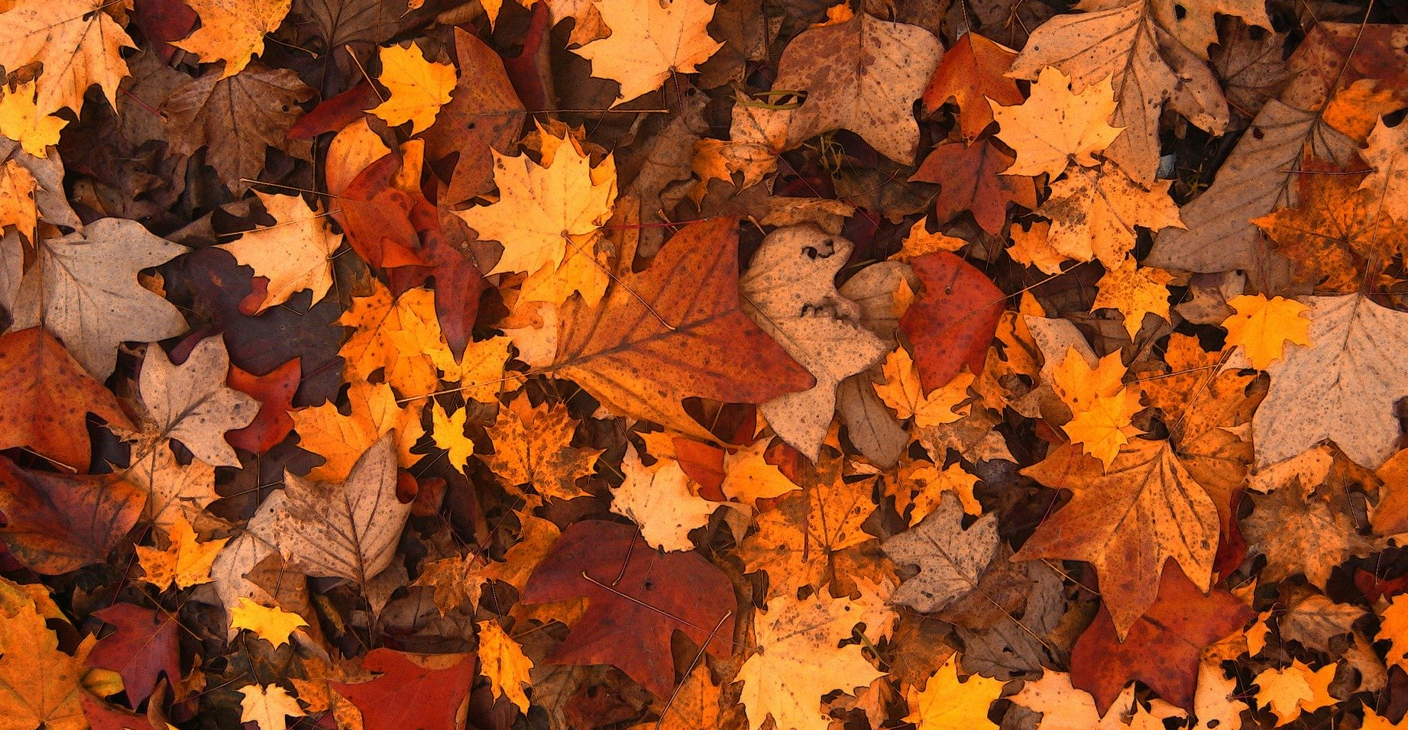
What Happens to the Trees in Autumn?
In autumn, the leaves start to turn bright colours and fall off the trees.

Slide 5
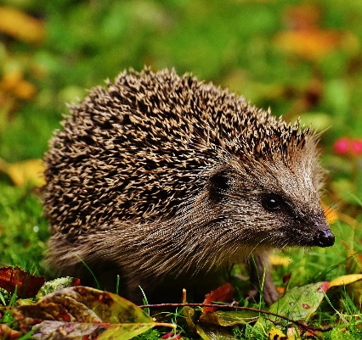
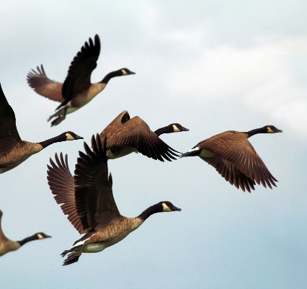
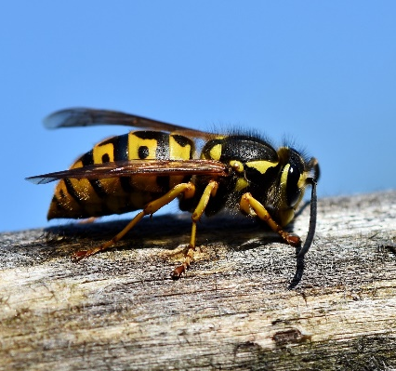
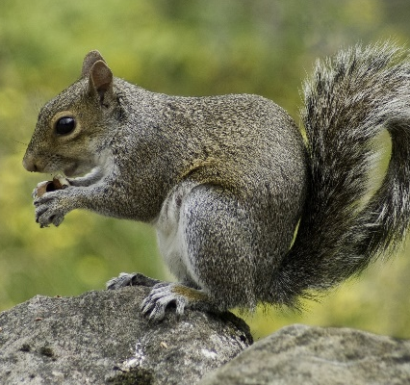
What Happens to the Animals in Autumn?
Hedgehogs hibernate through autumn and winter. This means they sleep until springtime.
Geese and lots of other birds migrate in autumn. This means they fly to find a warmer place to live until spring.
During autumn, squirrels collect lots of nuts and acorns. They hide them in the ground. During winter they stay in their nests and only come out to eat the food they have hidden.
Most wasps will die in autumn but the queen wasp will survive in the nest.

Slide 6
