Slide 2
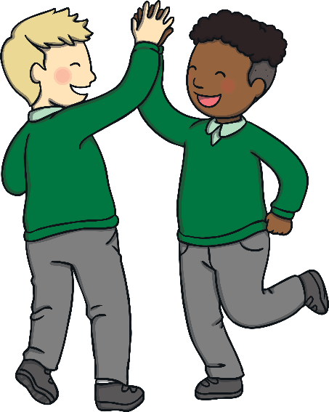
Everyone Has Different Strengths
We are all different and enjoy different things.
Some people are adventurous, some are creative, some are playful and some are all these things.
These are our traits. They are not fixed, they can change and we can work on the traits we want to be our strengths.
Look through the images and think about:
What does this trait ‘look like’ to other people?
Is this one of my strengths?
How can I make this a strength?

Slide 3
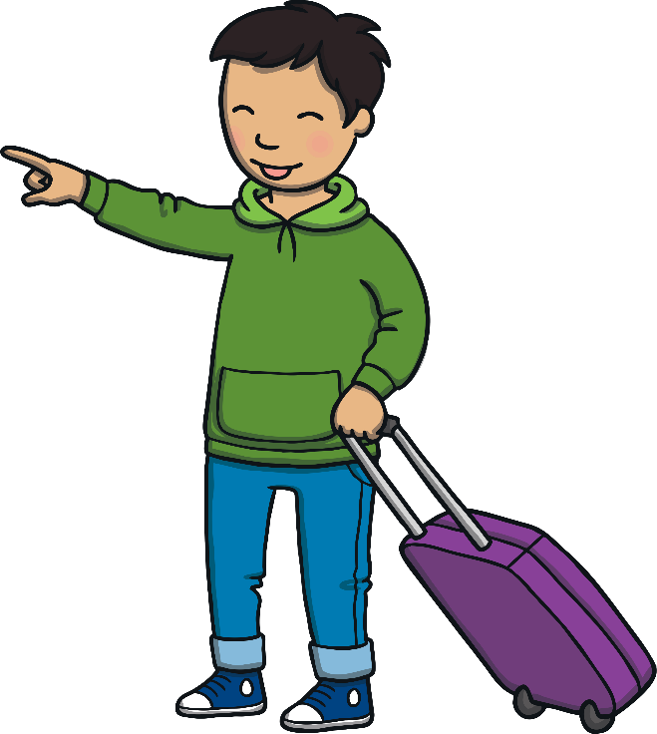
adventurous

Slide 4
fair

Slide 5
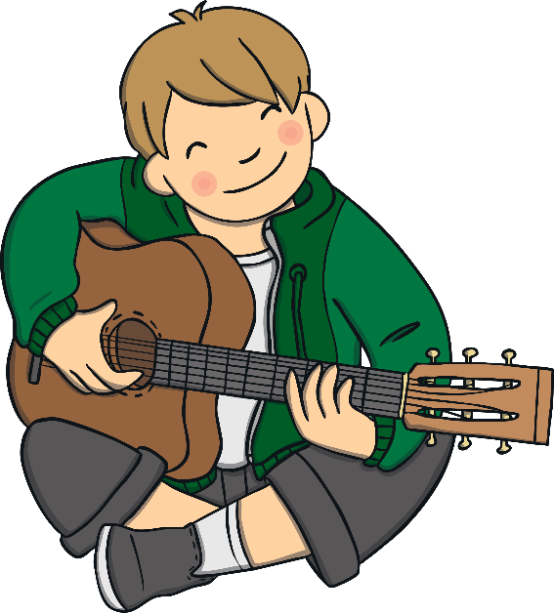
persistent

Slide 6
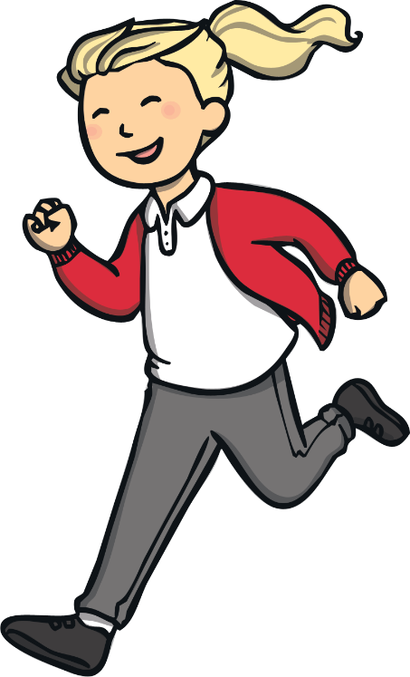
always trying

Slide 7
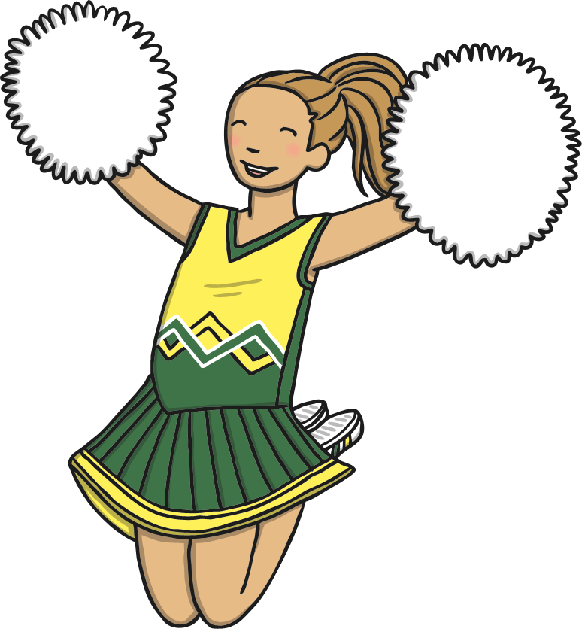
encouraging

Slide 8
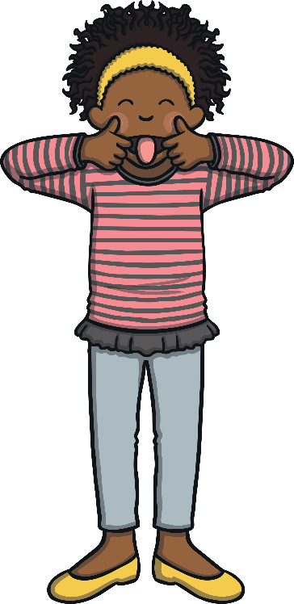
playful

Slide 9
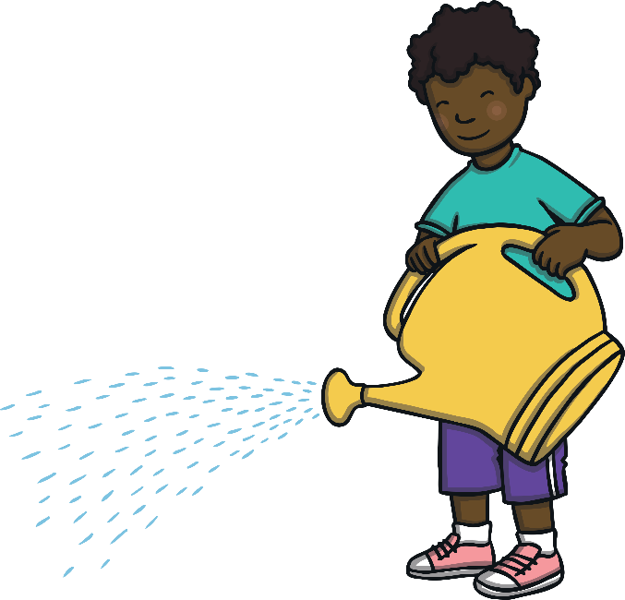
patient

Slide 10
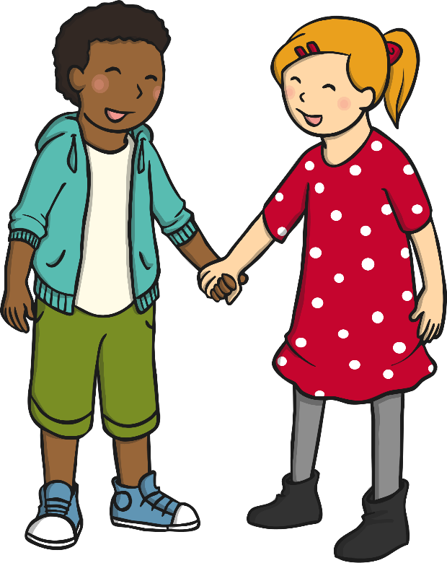
loyal

Slide 11
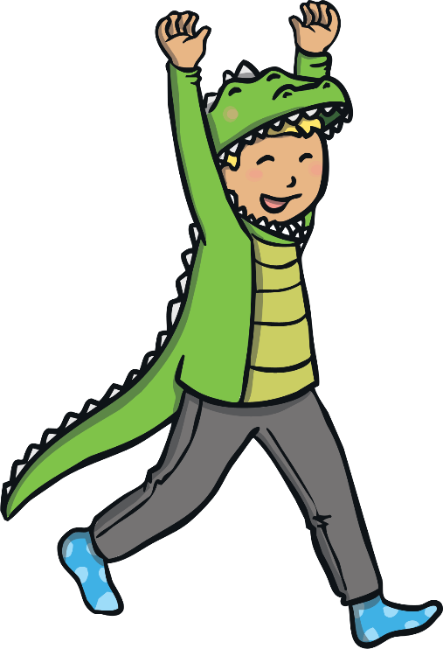
joyful

Slide 12
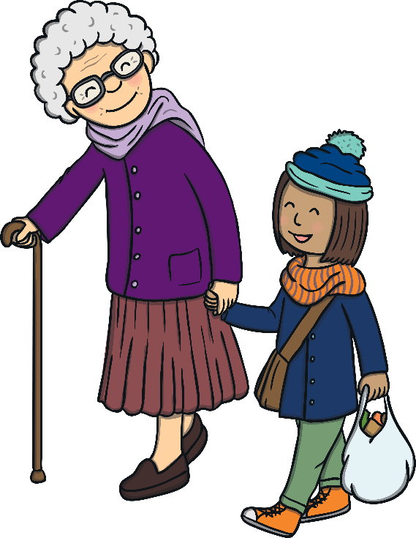
kind

Slide 13
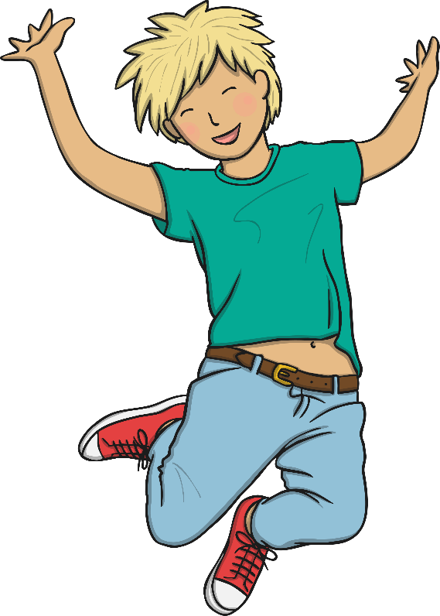
happy

Slide 14
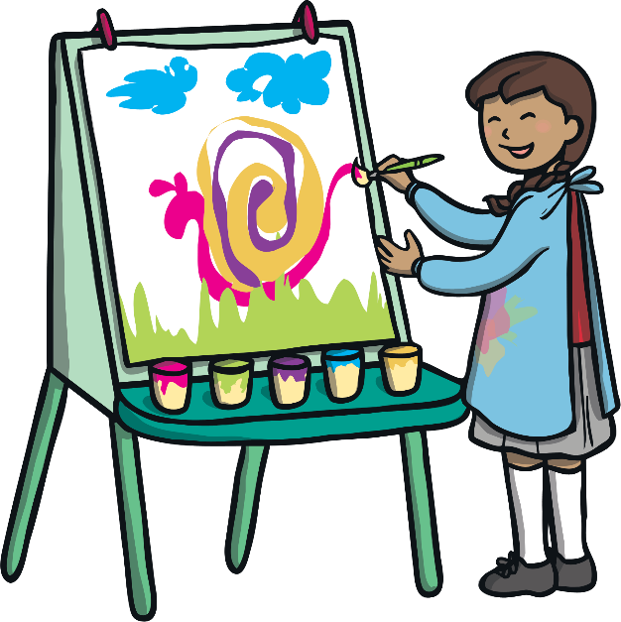
creative

Slide 15
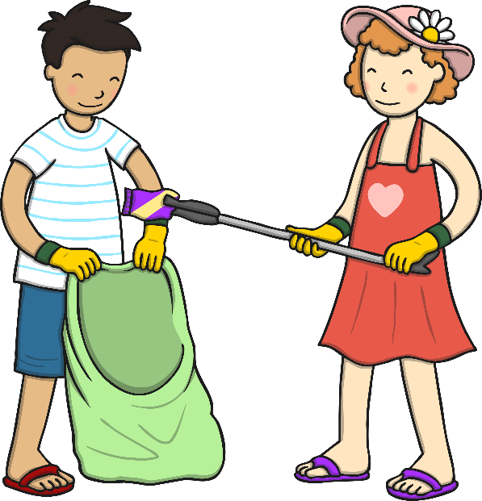
helpful

Slide 16
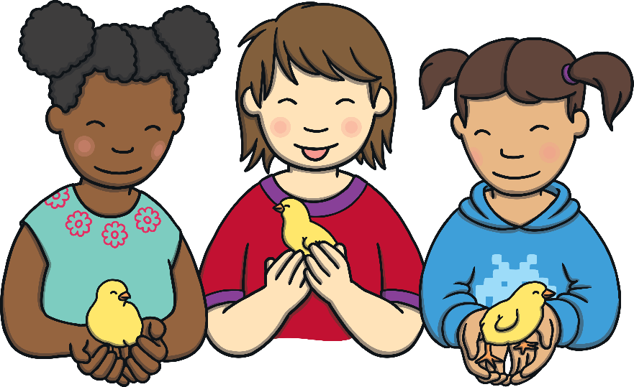
gentle

Slide 17
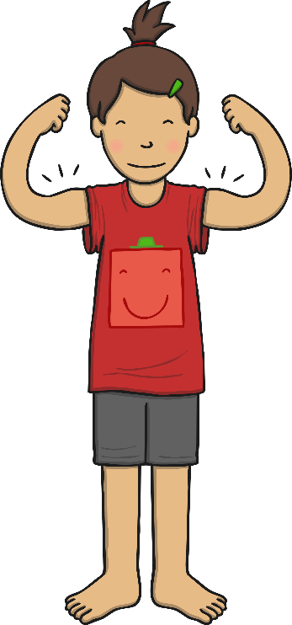
strong

Slide 18
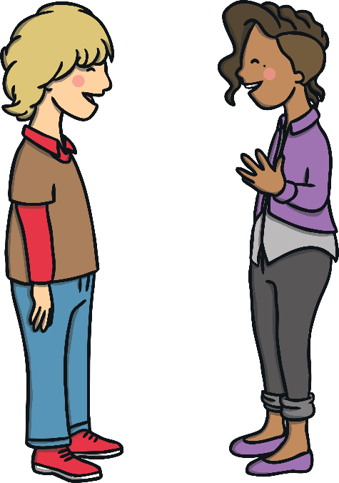
honest

Slide 19
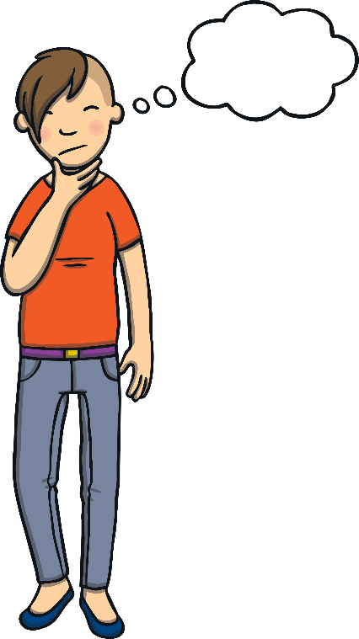
thoughtful

Slide 20
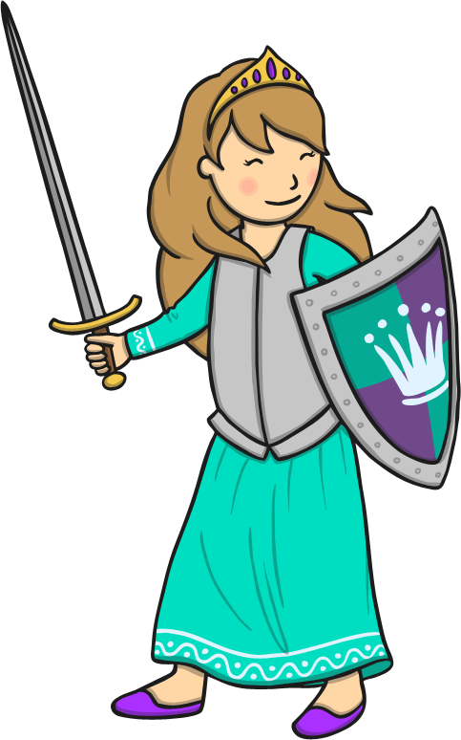
brave

Slide 21
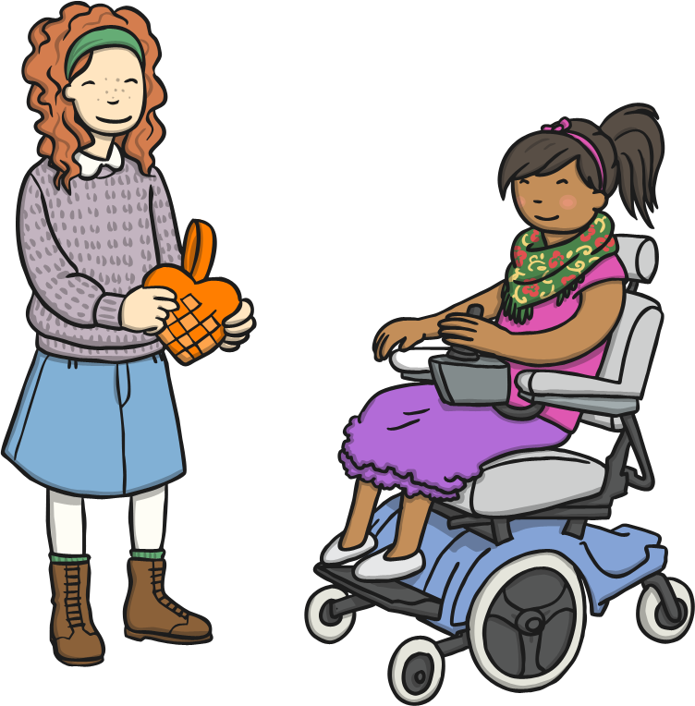
generous

Slide 22
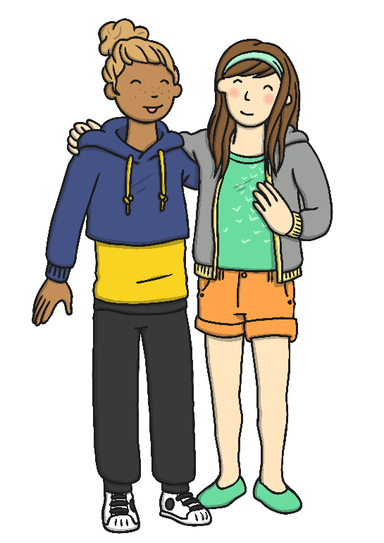
friendly

Slide 23
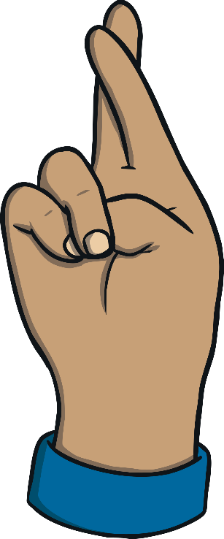
hopeful

Slide 24
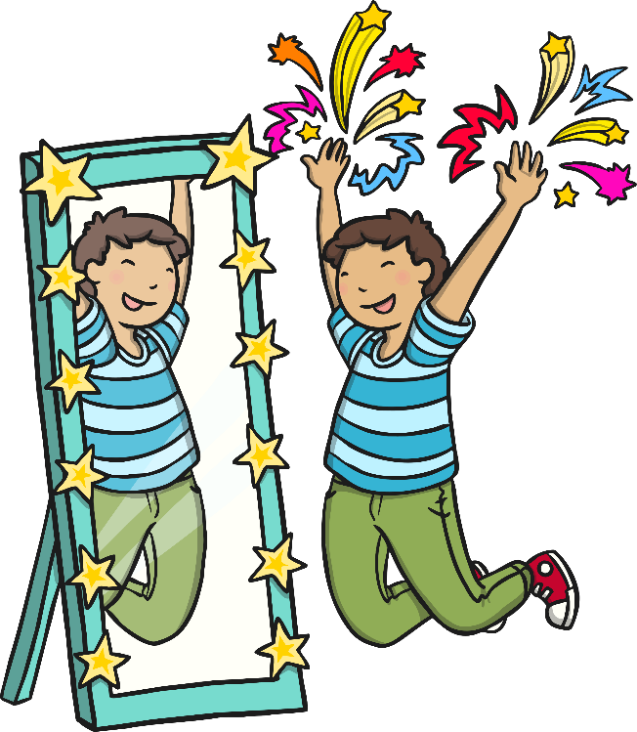
optimistic

Slide 25
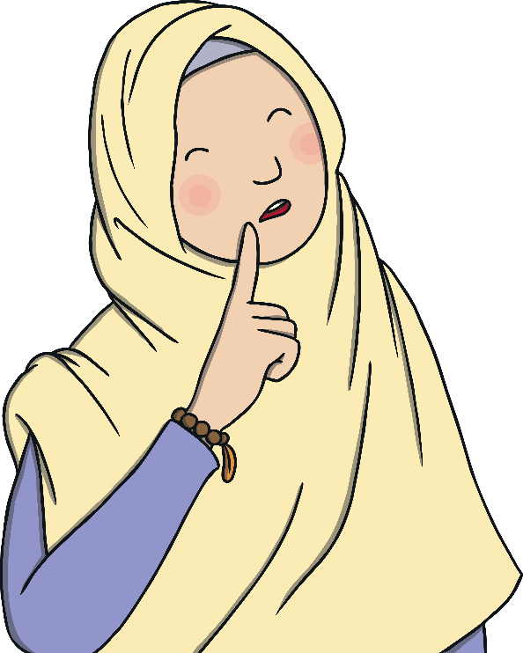
What other strengths can you think of?

