Slide 1
Spy School Spreadsheets
Lesson 6

Slide 2
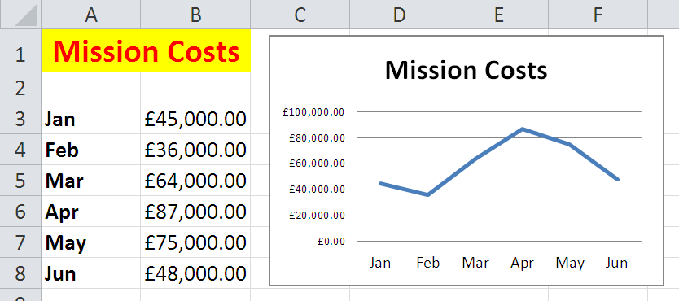
Starter
Create the following spreadsheet including the graph.

Slide 3
Objective of the lesson
Use absolute and relative cell references, model data and create a spreadsheet.
All of you will:
Use relative cell references and absolute cell references.
Change data in a spreadsheet.
Create a basic spreadsheet.
Most of you will:
Understand the difference between absolute and relative cell references.
Model data to get answers out of a spreadsheet.
Create a working spreadsheet.
Some of you will:
Compare results using a pie chart.

Slide 4
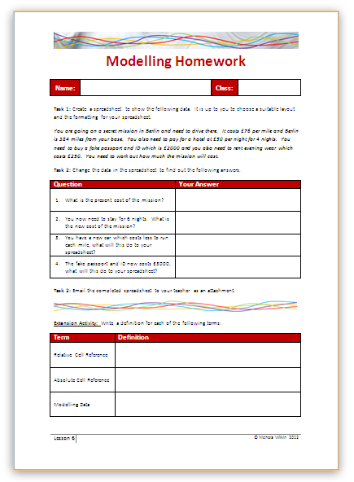
Homework
Everybody should complete Tasks 1 to 3 to create a spreadsheet and use it to model different scenarios.
Some of you may also want to get the extra marks by completing the extension activity.
This homework is due in next lesson.
Make sure you have written your homework clearly in your planner.

Slide 5
Absolute and Relative cell references
So far you have been using AutoFill to replicate formula and functions in your spreadsheet.
This uses “Relative” cell references.
A relative cell reference can change where it is pointing to when it is replicated so the formula works for other cells.

Slide 6
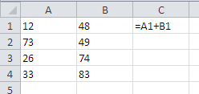
Relative cell reference
Look at this simple spreadsheet.
What will it do?

Slide 7
Relative cell reference
What will happen to the formula when it is replicated down to the rest of the cells using AutoFill?

Slide 8
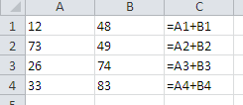
Relative cell reference
As you can see the formula is copied but it is looking at different cells each time. It is only following the pattern so the other formulae work correctly.

Slide 9
Absolute cell references
“Absolute” cell references are slightly different. Instead of it changing cells when the formula is replicated, it locks onto a cell and always goes back to the same cell.

Slide 10
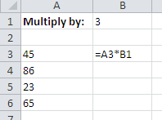
Absolute cell references
Look at this spreadsheet.
What do we want it to do?

Slide 11
Absolute cell references
What will happen when the current formula is filled down?

Slide 12
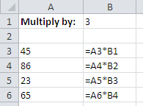
Absolute cell references
Is this what we would want to happen?
No, we want it to go back to B1 each time.

Slide 13
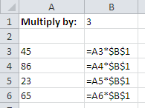
Absolute cell references
What is different in this formula?

Slide 14
Absolute Cell References
These are the cell references which lock onto one cell so that when the formula is replicated it does not move away from that cell.
You can create an absolute cell reference by typing in the $ symbols in front of each part ($B$1) or by entering the cell reference and then hitting the F4 key on your keyboard.

Slide 15
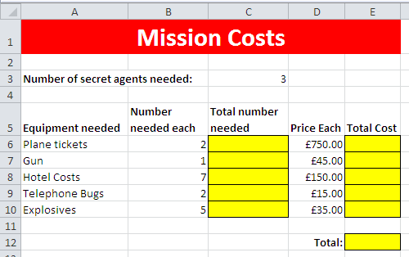
Absolute cell referencing
Copy the Absolute spreadsheet from the school’s network into your own work area.

Slide 16
Absolute Cell Reference
Create a formula which will multiply the number of the equipment needed by the secret agents needed for the mission

Slide 17
Absolute Cell Reference
Multiply the total number needed by the price each

Slide 18
Absolute Cell Reference
Work out the total

Slide 19
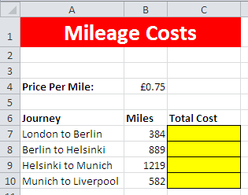
Over to you…
Go to the Travel worksheet.
You are on a new mission which involves driving around Europe and you need to work out how much this will cost.

Slide 20
Modelling Data
Organisations use spreadsheets to test out scenarios.
They may experiment with the figures to see what would happen if they increased the price of the product, changed suppliers and reduced costs or even sold things on a special offer (buy one get one free).
This is known as “modelling” data.

Slide 21
Modelling data
You are going to be using the spreadsheet you have just been working on to “model” different scenarios.
Go back to the Practice worksheet.
We are going to change the numbers on the spreadsheet to see what happens to other cells which contain formulae.

Slide 22
Modelling data
What is the present cost of the mission?
Change the number of secret agents in C3 to 4. What is the new cost of the mission?
The mission is going to go on longer than expected. They need to stay for 10 nights in the hotel. What is the new cost of the spreadsheet?
The price of plane tickets is now £500 each. What do you think that will do to the overall cost of the mission?

Slide 23
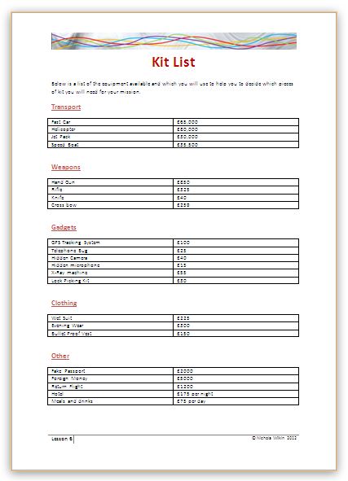
Your Mission
You have been chosen to go on a secret mission.
You need to plan your mission and have to work out the total cost.
Look through the kit list and make a selection of what you want to use on your secret mission.

Slide 24
Make a spreadsheet
Create a spreadsheet to work out the total amount your mission will cost and the average cost of the equipment you have chosen.
You will need to fly to the location and stay for at least 7 nights. You will also need transport when you are there, weapons and a few spy gadgets.
Make sure you include:
A main title
Suitable headings
Format the data correctly
Complete the calculations that are needed
Save your spreadsheet with a suitable name in your location.

Slide 25
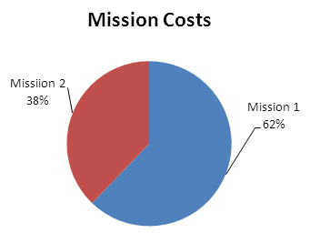
Extension Activity
On the same spreadsheet price up a second mission and create a pie chart to compare the two missions.

Slide 26
Email your spreadsheet to your teacher
Send your teacher an email and include the spreadsheet you have created as an attachment.

Slide 27
Plenary
Answer the following questions:
What do we mean by the phrase “replicate a formula”?
What is an absolute cell reference?
What do we mean by the phrase “modelling data”?
Why do companies use a spreadsheet to model data?

