Slide 1
Spy School Spreadsheets
Lesson 5

Slide 2
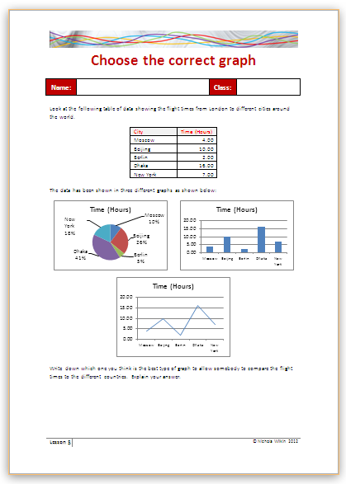
Starter
Work in pairs to decide which of the three graphs allow the reader to compare the data easily.

Slide 3
Objective of the lesson
Create a variety of graphs in a spreadsheet.
All of you will:
Create a bar and pie chart.
Most of you will:
Format the graphs appropriately and use data which is not next to each other on the spreadsheet.
Some of you will:
Create a spreadsheet and graph from scratch and use the graph to answer questions.

Slide 4
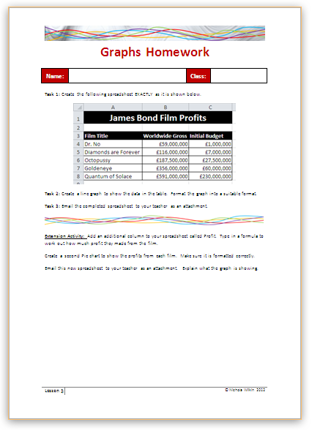
Homework
Everybody should complete Tasks 1 to 3 to create a spreadsheet and graph.
Some of you may also want to get the extra marks by completing the extension activity.
This homework is due in next lesson.
Make sure you have written your homework clearly in your planner.

Slide 5
Graphs
As a spy you would need to know about a number of different countries.
As there is a lot of data available it is a good idea to compare this data using a graph.
Many people find graphs easier to understand than looking at a page of numbers but you must make sure your graph makes sense and has a useful title so that people know what the graph is about.

Slide 6
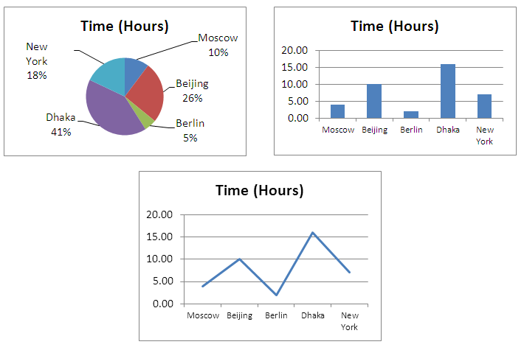
Creating a graph
Which type of graph did you decide upon in your pairs at the beginning of the lesson?

Slide 7
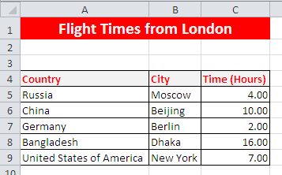
Copy the File
Copy the Country Data file from the school network into your work area.

Slide 8
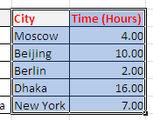
Creating a graph
Highlight the data as shown.
Click on the Insert a Column chart

Slide 9
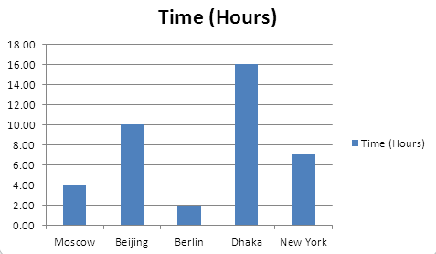
Parts of the Graph
Gridlines
Title
Legend
Y Axis
Data Series
X Axis

Slide 10
Formatting the graph
You can alter any of the parts.
Format the title.
Format the background colour
Format the Data Series
Move or even remove the Legend
Format the X and Y Axis titles
Remove the gridlines
Change your graph to make it look more interesting

Slide 11
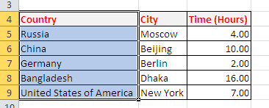
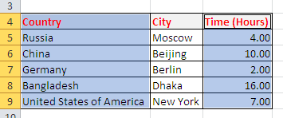
Creating Graphs
You can also create graphs from data that is not next to each other.
Highlight A4 to A9
Hold down the Ctrl key on the keyboard
Highlight C4 to C9 then release the Ctrl Key

Slide 12
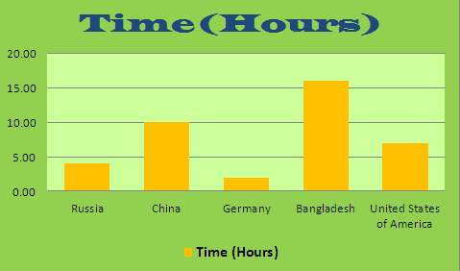
Creating Graphs
Create your graph as before. Format it to look as follows:

Slide 13
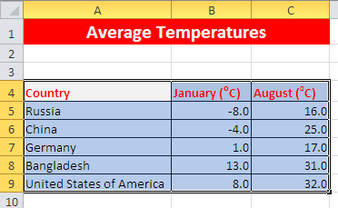
Creating Graphs
Select the second worksheet called Temperatures.
Highlight A4 to C9.
Create a graph to show this data.
What is different about this graph?

Slide 14
Pie Chart
A Pie Chart is used to show how much of the total each section takes up.
On the third worksheet called Population and area create a pie chart to show the population for each country.
Create a second pie chart to show the area of each country. (You will need to highlight data which is not next to each other.)

Slide 15
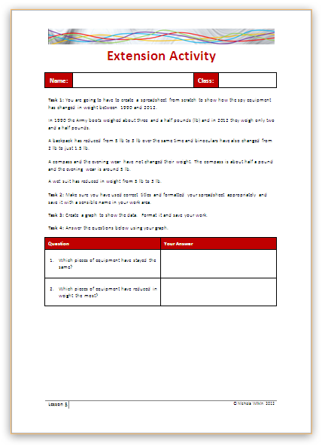
Extension Activity
Work through the handout to create a spreadsheet and graph and then use the graph to answer some questions.

Slide 16
Plenary
You are going to see three different types of graph and you need to give them their correct names.
Area
Doughnut
Bubble

