Slide 1
Spy School Spreadsheets
Lesson 4

Slide 2
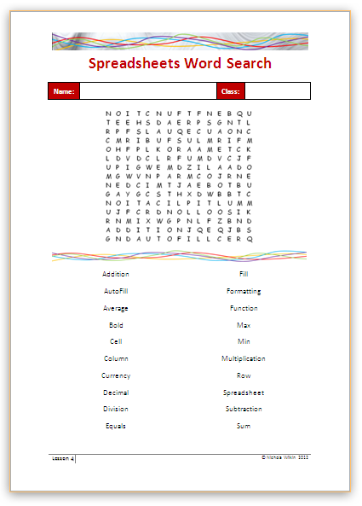
Starter
Work in pairs to complete the word search to recap some of the key terminology you have learnt so far.

Slide 3
Objective of the lesson
Sort and filter a spreadsheet and use comparator operators in a formula.
All of you will:
Sort a spreadsheet and apply a basic filter with help.
Use the > and < operators in a formula correctly.
Most of you will:
Filter data by more than one criteria
Use all the comparison operators correctly.
Some of you will:
Use advanced filtering criteria.

Slide 4
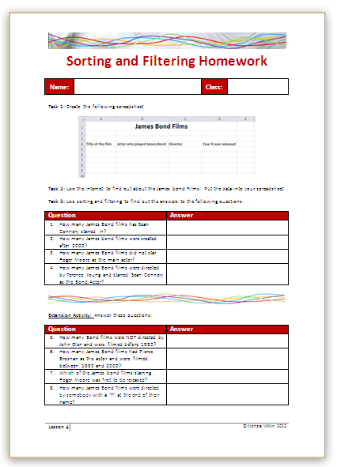
Homework
Everybody should complete Tasks 1 to 3 to create and use a spreadsheet about James Bond films.
Some of you may also want to get the extra marks by completing the extension activity.
This homework is due in next lesson.
Make sure you have written your homework clearly in your planner.

Slide 5
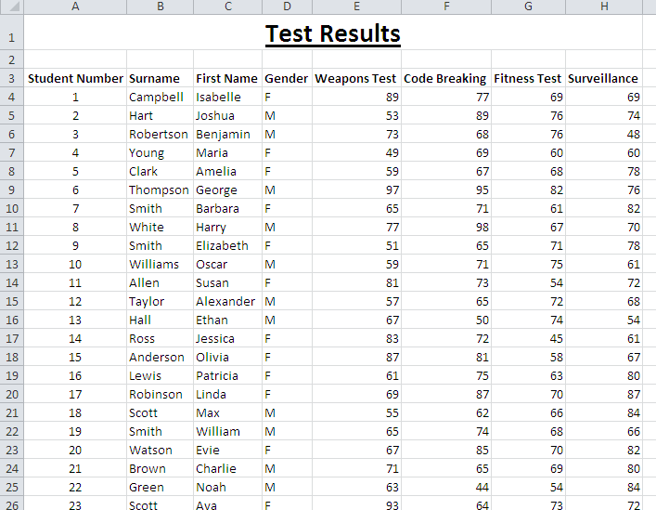
Copy the file
Copy the Test Results spreadsheet from the school’s network into your work area.
What does the spreadsheet show?

Slide 6
Sorting Data
Sorting data is when you change the order of the data.
Click in the Surname column
Click on the Sort and Filter button and then select Sort A to Z.
What has happened to the data?

Slide 7
Answer these questions:
Who got the highest mark in the weapons test?
Who got the lowest mark in the fitness test?
Who got the highest mark in the surveillance test?
Who got the lowest mark in the code breaking test?

Slide 8
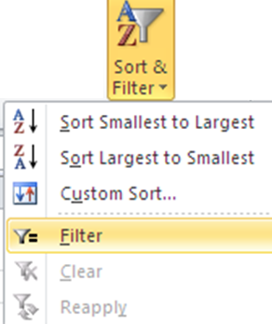
Filtering data
What is the difference between sorting and filtering data?
Sorting data means to put the data into a different order
Filtering data means to only see a few selected records from the data.
Click on the Sort and Filter button then select Filter from the menu.
What has happened to the data?

Slide 9
Filtering Data
Filter the data to only show the female students.
Click on the drop down column in the Gender column and select only F from the list then click on OK.
Look at the bottom of the screen to see how many results you get.

Slide 10
Removing the filter
Select the Filter option again and select the Select All option then click on OK.
It is a good idea to remove filters before you filter by something else unless you want to build up a more complex filter for instance Female AND called Smith.

Slide 11
Answer these questions:
How many students have the surname “Smith”?
How many have the surname “Clark” or “Taylor”?
How many male students are called “Smith”?
How many students scored exactly 65 on the code breaking test?

Slide 12
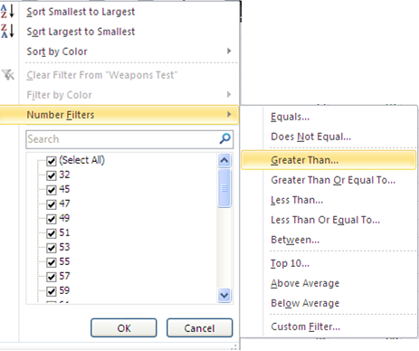
Range filter
Instead of only selecting an exact match, you can use a range filter.
Select the filter for the Code breaking tasks
Select Number Filters, then Greater Than and finally type in 60.
What is the answer?

Slide 13
Answer these questions:
How many pupils got over 60 in the weapons test?
How many male students got under 70 on the fitness test?
How many female students called Smith got over 70 on the code breaking test?
How many students start their surname with the letter “R”?

Slide 14
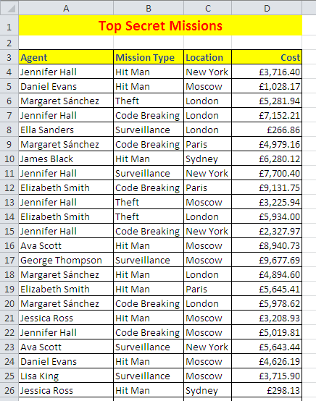
Copy the file
Copy the Secret Missions spreadsheet from the school’s network into your work area.

Slide 15
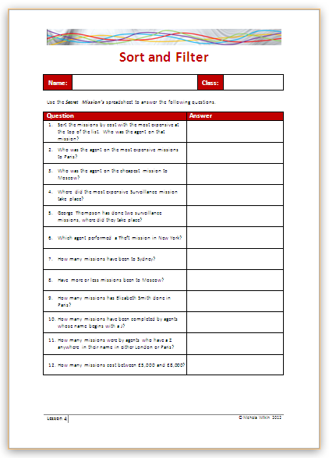
Sorting and Filtering data
Complete the handout by filtering the data in the spreadsheet.

Slide 16
Comparing data
As a spy you will need to work out some top secret codes.
You will be using comparison operators to help you to do this.
Comparison Operator | Description
> | Greater than
< | Less than
= | Equal to
>= | More than or equal to
<= | Less than or equal to
<> | Not equal to

Slide 17
Comparing data
When you compare data you are seeing if one value meets a rule about the other.
For instance:
Is 10 more than 5?
The answer would be “Yes” or as a spreadsheet understands it “True”.
Is 20 less than 10?
No it isn’t so the answer would be “False”

Slide 18
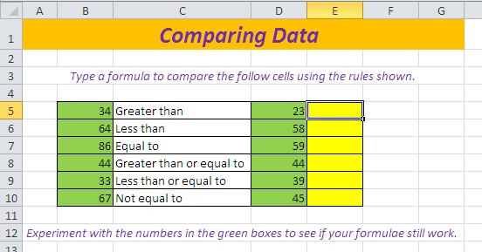
Comparing data
Copy the Comparison Operators spreadsheet from the school’s network into your own work area.

Slide 19
Work through the spreadsheet
There are three worksheets on the spreadsheet. Work through them in order.
Read the instructions on each sheet so you know what you need to do.

Slide 20
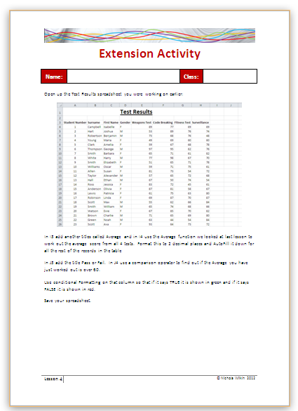
Extension Activity
Work through the handout to recap a function, AutoFill, the comparison operators and conditional formatting.

Slide 21
How much do you remember?
What is the difference between sorting and filtering data?
Describe how you would apply a filter to some data.
Describe how you would remove a filter.
Name the Comparison Operators.
Why do people use computerised spreadsheets rather than working everything out on paper?

