Slide 1
Spy School Spreadsheets
Lesson 3

Slide 2
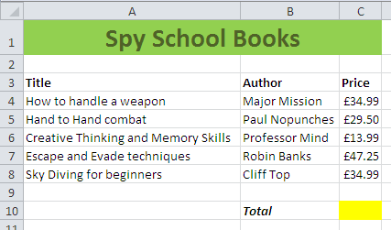
Starter
Create the following spreadsheet, format it as shown and complete the formula in the yellow box.

Slide 3
Objective of the lesson
To be able to use a range of functions in a spreadsheet.
All of you will:
Use the basic functions SUM, AVERAGE, MIN and MAX in a spreadsheet.
Most of you will:
Create a simple spreadsheet from scratch, format it and use formula and functions effectively.
Some of you will:
Use the COUNTA and text functions.

Slide 4
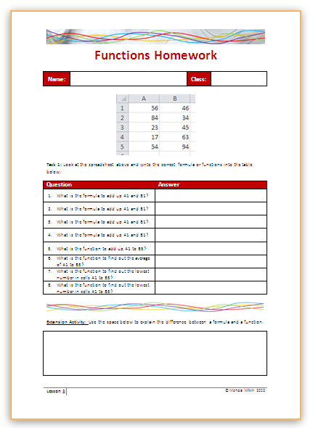
Homework
Everybody should complete Task 1 to answer questions about formula and functions.
Some of you may also want to get the extra marks by completing the extension activity.
This homework is due in next lesson.
Make sure you have written your homework clearly in your planner.

Slide 5
Formula v Functions
What Formula could I type into A8 to add up the other cells?
=A1+A2+A3+A4+A5+A6+A7
Imagine if this list had over a hundred entries in it. Would this be efficient?
You would take a long time to type in the formula and you are likely to make an error and possibly miss out a cell or even include it twice in the formula.

Slide 6
Formula v Functions
A better option would be to use a Function.
=SUM(A1:A7)
All calculations start with an =
The : symbol means “to”
Put cell references in brackets
SUM means “add together”
Enter the starting and ending cells for the range.

Slide 7
Functions
Functions have a different look to formulae.
A formula lists each cell individually and puts the correct mathematical operator between them.
A function deals with a whole range of cells in one go and puts the function name at the beginning to say what you want to do with that range.
=A1+A2+A3+A4+A5+A6+A7
=SUM(A1:A7)

Slide 8
Functions
There are lots of different functions.
Function | Description
=SUM(A1:A7) | This would add up the cells from A1 to A7
=AVERAGE(A1:A7) | This would work out the average of cells A1 to A7
=MIN(A1:A7) | This would find the lowest value from cells A1 to A7
=MAX(A1:A7) | This would find the highest value from cells A1 to A7

Slide 9
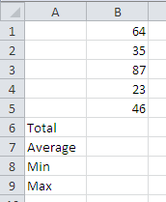
Create a spreadsheet
Create a new spreadsheet and enter the data as shown on the right.
In B6 enter a function to add up B1 to B5
In B7 enter a function to find the average from cells B1 to B5 (shown to 2 decimal places)
In B8 enter a function to find the lowest value from B1 to B5
In B9 enter a function to find the highest value from B1 to B5

Slide 10
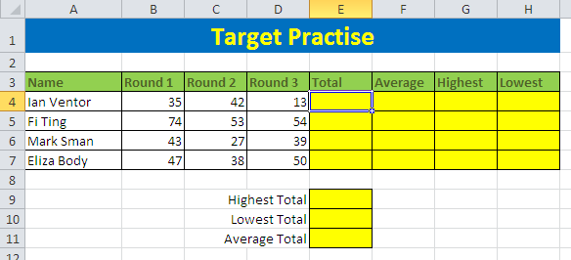
Copy the file
Copy the Basic Functions spreadsheet from the school’s network into your work area.

Slide 11
AutoFill
AutoFill allows you to replicate a formula from one cell into others.
To AutoFill a cell, enter the correct formula in one cell
Click the bottom right of the cell and drag it to the new location to replicate it.
Drag the cell by the bottom right corner to AutoFill it.

Slide 12
Complete the spreadsheet
Complete the functions needed for the spreadsheet then use the AutoFill tool to replicate it into other cells.

Slide 13
Create a spreadsheet
You need to create your own spreadsheet using the tools you have learnt so far.
The Spy School is planning a trip and needs to find out how much each pupil has paid towards the trip. The trip costs £73 each.
So far Ian Ventor has paid £20, Fi Ting has paid £35, Mark Sman has paid £50 and Eliza Body has paid £23.
Find out how much they still have left to pay and use some of the functions you have learnt to find out the total and average of the amounts paid.
Format your spreadsheet and save it with a sensible name.

Slide 14
Extension Activity
Copy the More Functions spreadsheet into your work area.
Read the instructions and complete the CountA and Text sheets.

Slide 15
How much do you remember?
Work in pairs to answer these questions.
What is AutoFill used for?
Why would you use a function rather than a formula?
What does the SUM function do?
How can you find the lowest value from a range of cells?

